Slide 1
ASSESSING PEDESTIRANS’ EXPOSURE TO TRAFFIC NOISE WITH SPATIAL ANALYSIS:
THE EFFECTS OF ROUTE CHOICE AND HOME LOCATION
-
Working title
Preliminary methods & results
Joose Helle

Slide 2
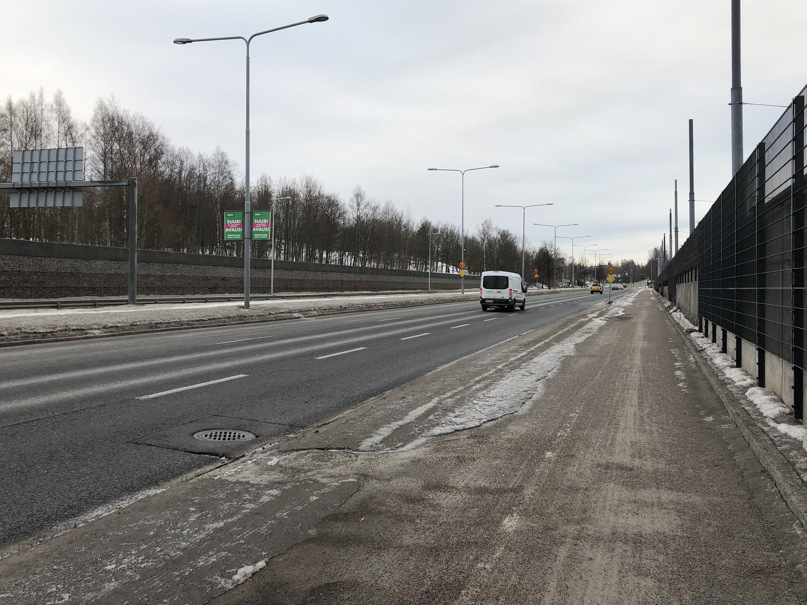
QUIET PATH ROUTE OPTIMIZATION

Slide 3
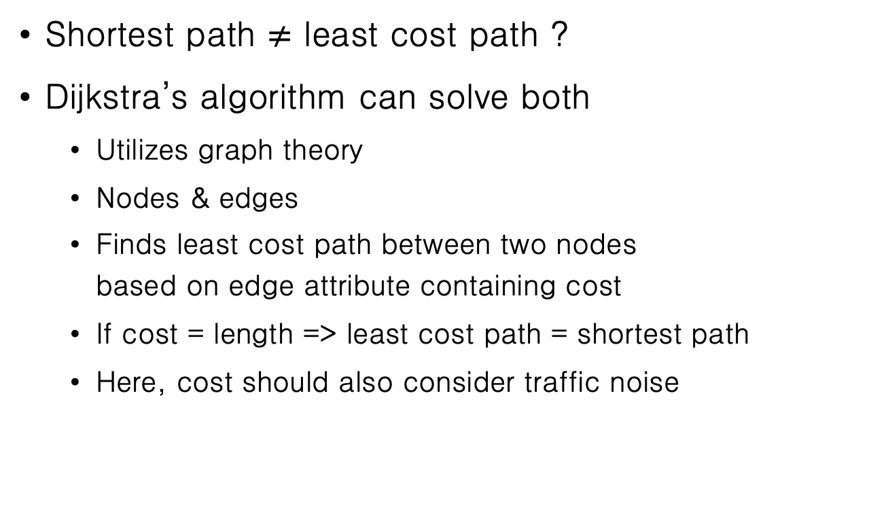
LEAST COST PATH
Shortest path $≠$ least cost path ?
Dijkstra’s algorithm can solve both
Utilizes graph theory
Nodes & edges
Finds least cost path between two nodes based on edge attribute containing cost
If cost = length => least cost path = shortest path
Here, cost should also consider traffic noise

Slide 4
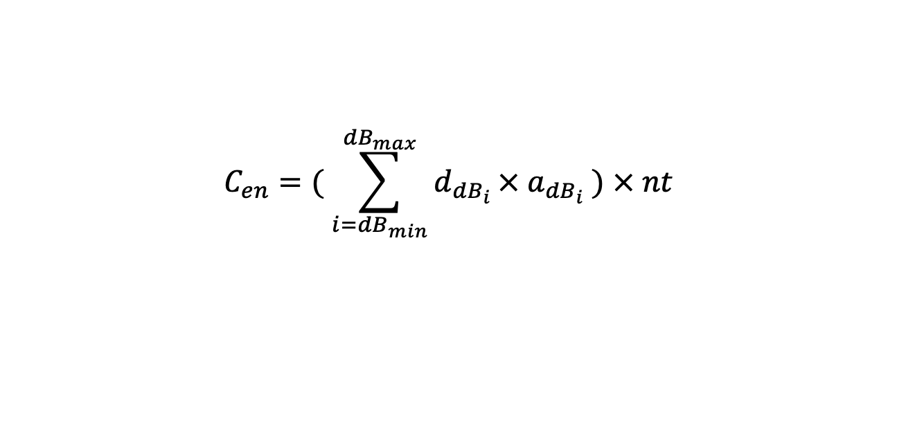
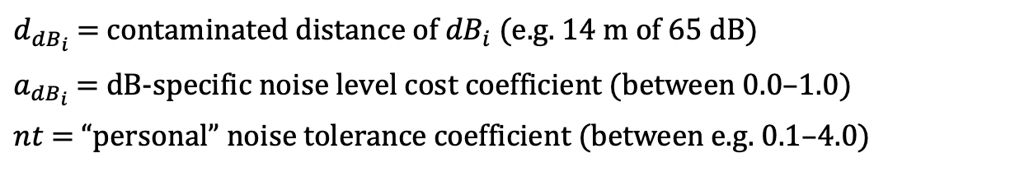
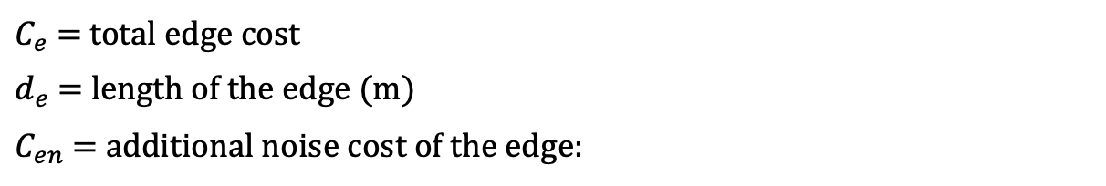
CALCULATING ADJUSTED EDGE COSTS
$$C_{e}=d_{e}+C_{en}$$
$C_{e}$ = total edge cost
$d_{e}$ = length of the edge (m)
$C_{en}$ = additional noise cost of the edge:
$$C_{en}=( \sum_{i={dB}_{min}}^{{dB}_{max}}{d_{{dB}_{i}}}× a_{{dB}_{i}} ) × nt$$
$d_{{dB}_{i}}$ = contaminated distance of ${dB}_{i}$ (e.g. 14 m of 65 dB)
$a_{{dB}_{i}}$ = dB-specific noise level cost coefficient (between 0.0–1.0)
$nt$ = “personal” noise tolerance coefficient (between e.g. 0.1–4.0)

Slide 5
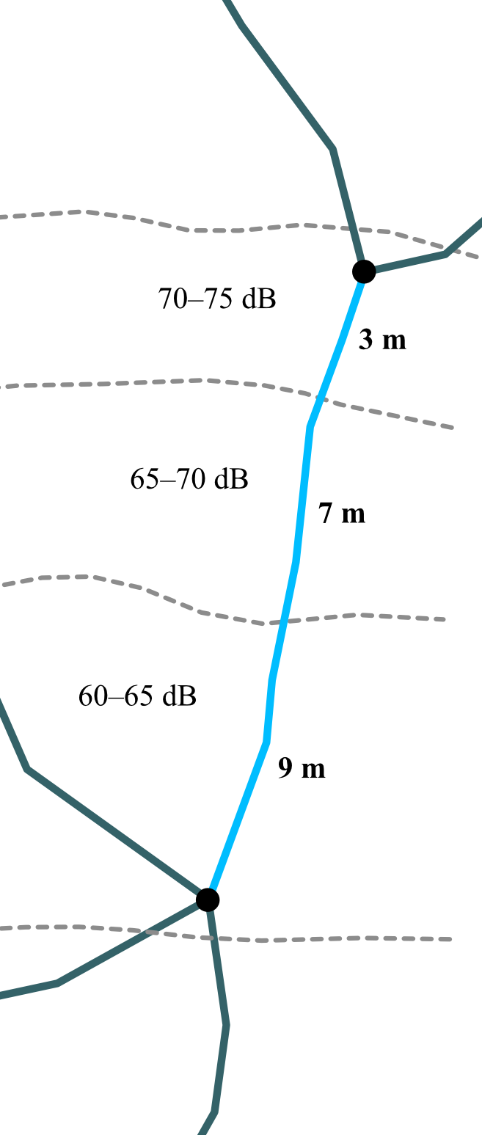
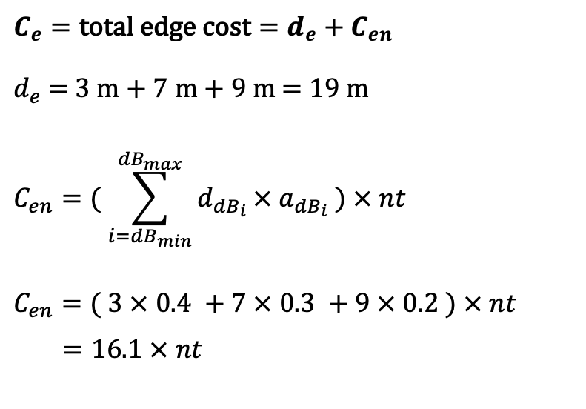
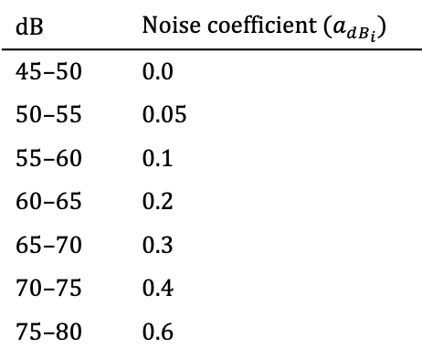
$$C_{e}=\text{total} \text{edge} \text{cost}=d_{e}+C_{en}$$
$d_{e}$ = 3 m + 7 m + 9 m = 19 m
$$C_{en}=( \sum_{i={dB}_{min}}^{{dB}_{max}}{d_{{dB}_{i}}}× a_{{dB}_{i}} ) × nt$$
$$C_{en}=( 3 × 0.4 +7 × 0.3 +9 × 0.2 ) × nt$$
$=16.1 × nt$
dB | Noise coefficient ($a_{{dB}_{i}}$)
45–50 | 0.0
50–55 | 0.05
55–60 | 0.1
60–65 | 0.2
65–70 | 0.3
70–75 | 0.4
75–80 | 0.6

Slide 6
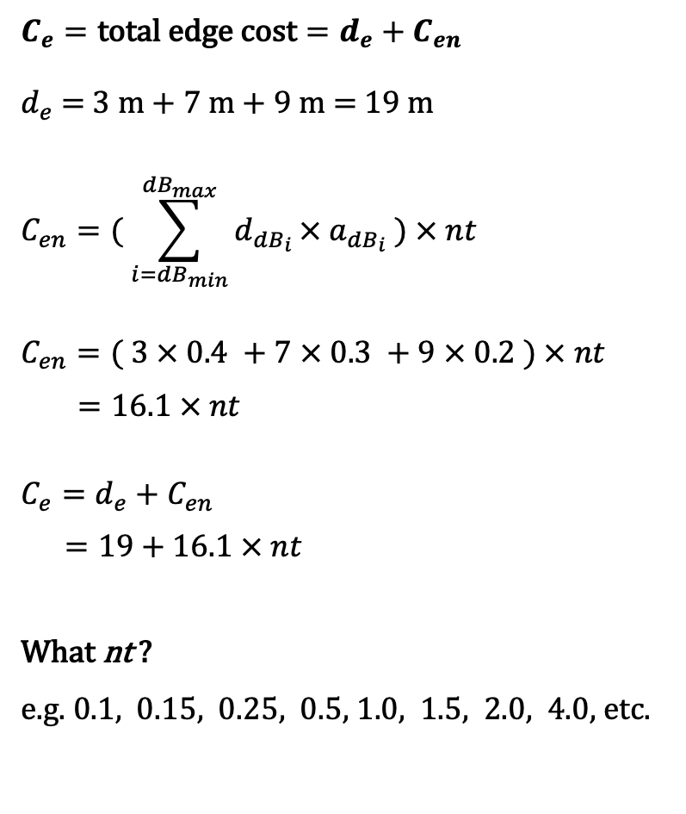
$$C_{e}=\text{total} \text{edge} \text{cost}=d_{e}+C_{en}$$
$d_{e}$ = 3 m + 7 m + 9 m = 19 m
$$C_{en}=( \sum_{i={dB}_{min}}^{{dB}_{max}}{d_{{dB}_{i}}}× a_{{dB}_{i}} ) × nt$$
$$C_{en}=( 3 × 0.4 +7 × 0.3 +9 × 0.2 ) × nt$$
$=16.1 × nt$
$$C_{e}=d_{e}+C_{en}$$
$=19+16.1 × nt$
What nt ?
e.g. 0.1, 0.15, 0.25, 0.5, 1.0, 1.5, 2.0, 4.0, etc.

Slide 7
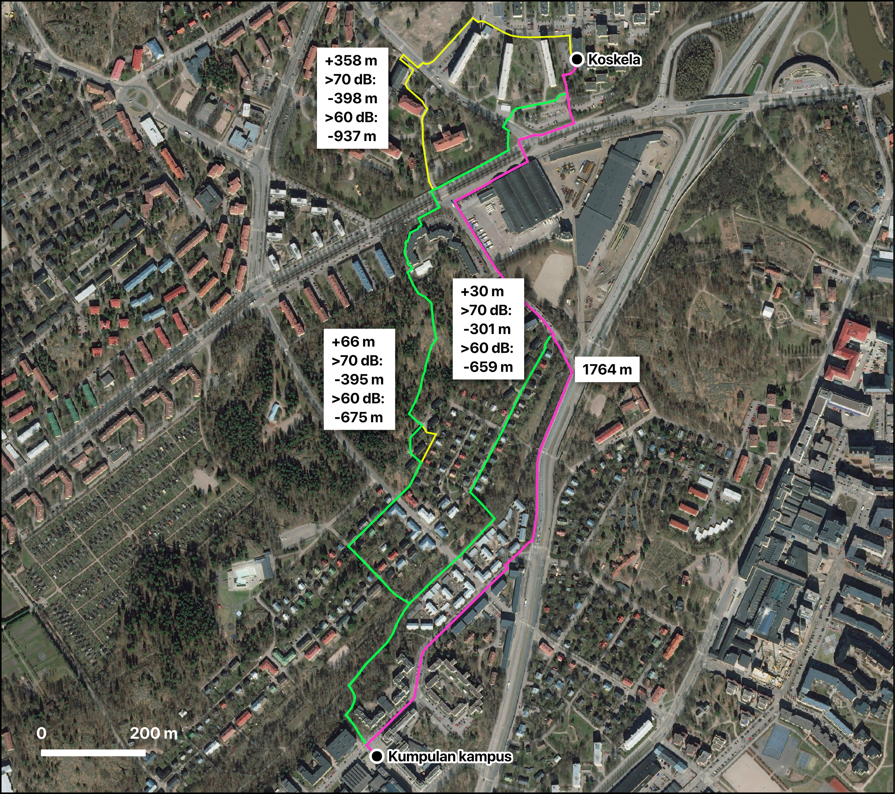

Slide 8
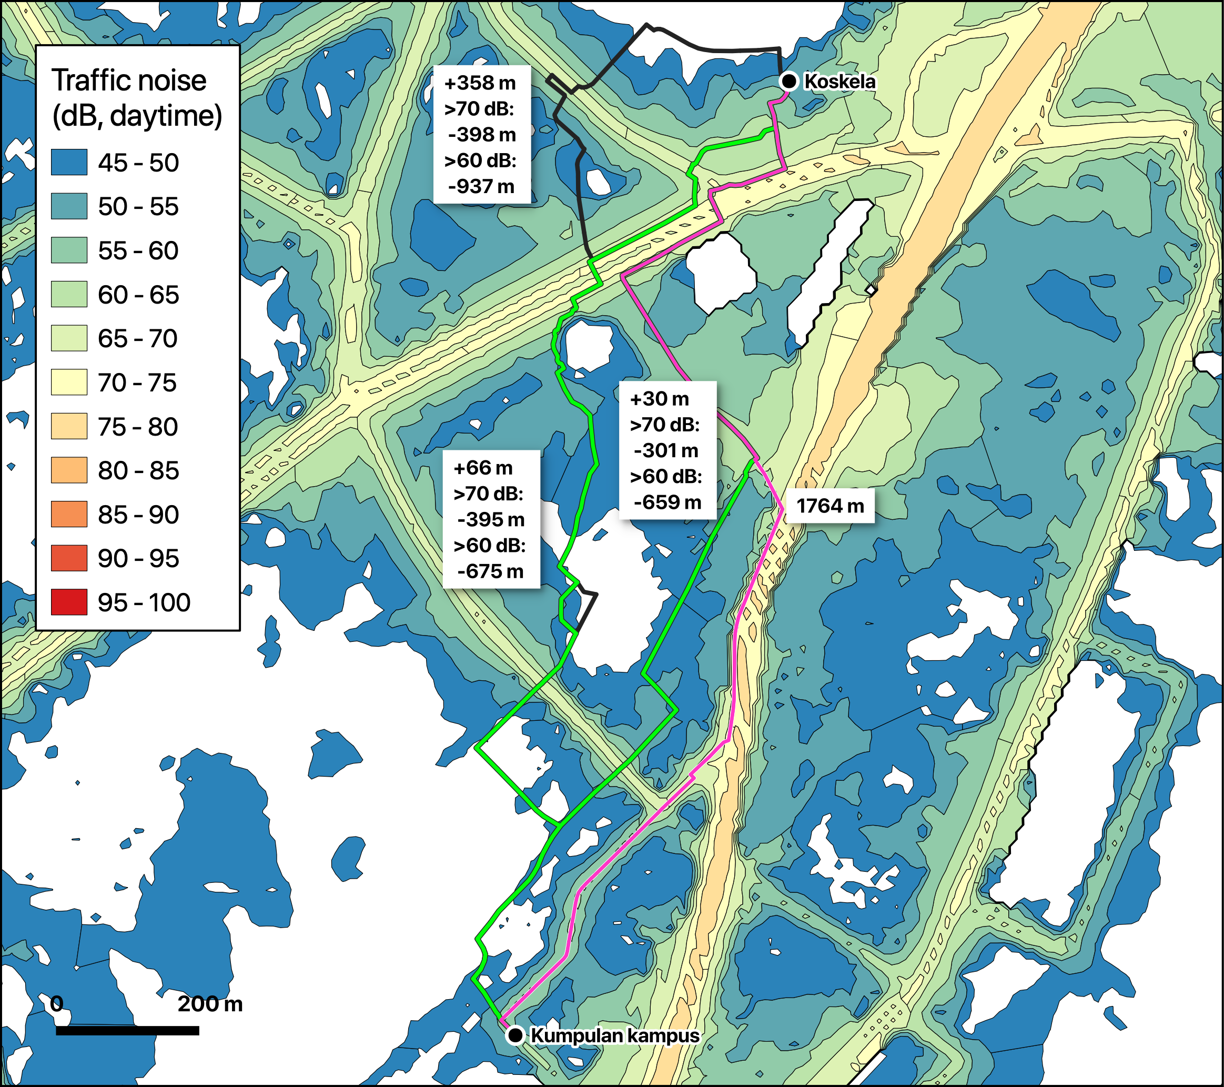

Slide 9
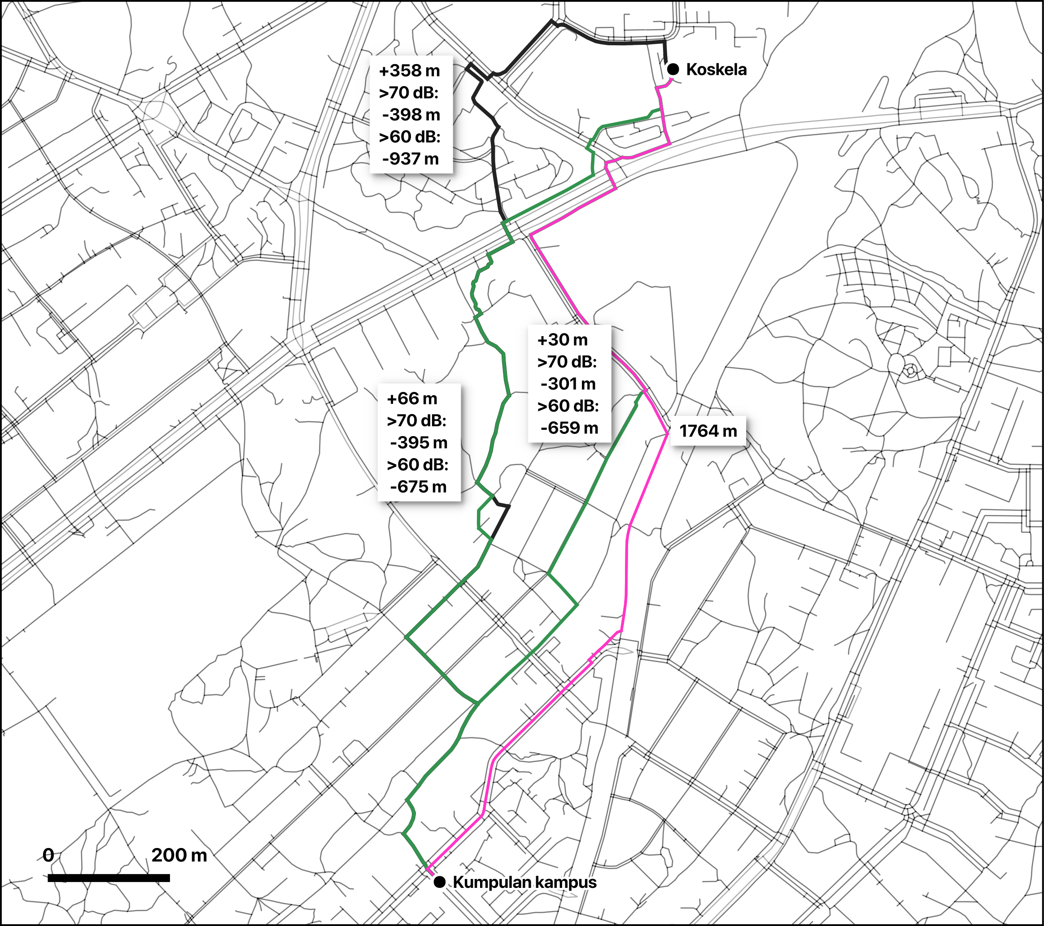

Slide 10
HOW TO COMPARE ALTERNATIVE PATHS ?
Type | nt | Length (m) | Length diff (m) | Length diff (%) | Diff. 60 dB (m) | Diff. 70 dB (m)
short | 0 | 1764 | 0 | 0 | 0 | 0
quiet | 0,15 | 1794 | 30 | 1,7 | -659 | -302
quiet | 1,5 | 1830 | 66 | 3,7 | -675 | -395
quiet | 6 | 2123 | 358 | 20,3 | -937 | -398

